Slide 1


Cultivating High Performance Teams to Deliver Results
June 2017
Robin Yeman
Lockheed Martin Corporation
Robin.Yeman@lmco.com
Dr. Suzette S. Johnson
Northrop Grumman Corporation
Suzette.Johnson@ngc.com
Approved for Public Release, #17-1161 ; Unlimited Distribution
© 2017 LOCKHEED MARTIN CORPORATION

Slide 2
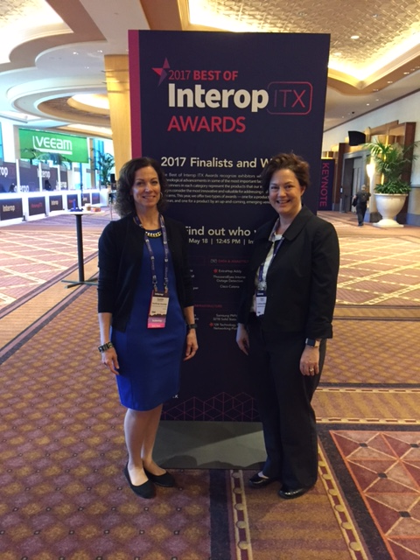


Introduction
Suzette
Robin
© 2017 LOCKHEED MARTIN CORPORATION
© 2017 Northrop Grumman Systems Corporation

Slide 3

Journey to Agile and DevOps
First
Approach
to Agile
Results
Achieved
© 2017 LOCKHEED MARTIN CORPORATION
© 2017 Northrop Grumman Systems Corporation

Slide 4
Suzette’s First Adventure
2005 a large data collection system to support the warfighter
Needed regular delivery of information to the field
10 Teams of ( ~10 people; 125 person team as part of a larger systems integration environment.)
Problem:
Read everything I could about Agile & attend training ( Ken Schwaber / Mike Cohn)
Trained the team after just ‘reading a book’ didn’t seem to be enough
Focused on scaling agile, systems engineering, quality, security, transparency
Made some mistakes = quality a big issue early one
Actions:
Great award fees from customer
Delivered on budget and met schedules on a three month cycle
Focused on automated testing and improving lead time (<12,000 tests per day)
Defined the art of the possible and started meetings with great minds every other Thursday during lunch
Outcome:
Identify small steps of improvement with goals and metrics
Be clear about the goal and know where you are headed
Whole team collaborative planning
Goals around automated testing, intentional architecture, and you are never done
Lessons
Learned:
© 2017 Northrop Grumman Systems Corporation

Slide 5
Robin’s First Adventure
Problem:
Classified Asset Management System – 2 years ($80M)
Organization required Agile – 2002 // New Approach
8 Teams of ( 8-10)
Read everything I could about Agile & Attend Training ( Ken Schwaber / Mike Cohn)
Understand Contract / Vision / Customer
Engaged the teams define rhythms and product backlog
Made some mistakes
Actions:
Multiple 100% Award fees from customer
Delivered on budget, slightly over schedule
Made a lot of long term friends
Defined the art of the possible
Outcome:
Communicate Success and Failure early & often ( Own results)
Always Begin and End with the team
Include everyone in the teams ( Not just Software / Systems / Test)
Measure results and review regularly
Lessons
Learned:
© 2017 LOCKHEED MARTIN CORPORATION

Slide 6
Journey to Agile and DevOps
Achievements
To
Date
Growing
The
Organization
First
Approach
to Agile
Results
Achieved
© 2017 LOCKHEED MARTIN CORPORATION
© 2017 Northrop Grumman Systems Corporation

Slide 7
Suzette’s latest Adventure
Growing Agile and DevOps practices at scale in unique domains
Common mindset and addressing misconceptions
Functional silos and internal processes (HW/SW/IT/PMO/Subcontracts)
Build the skills
Dealing with Existing processes and compliance concerns
Problem:
Learn everything I can about Agile / DevOps / SecOps/ Cyber / Lean /People
Understand Customer goals and concerns (what problem are we trying to solve)
Agile Center of Excellence, Internal Coaching, Build the infrastructure
Define the delivery pipeline, tools, automation, with training and coaching
Transformation strategy and continuous improvement
Actions:
Improved quality with significant improvements
Received Fellowship
Very active communities of practice
Increased awareness and conversations on how we can deliver better
Lead by example
Outcome:
Build more champions than you think you need
Look both internally and externally for new idea’s ( meet-ups, Blogs, Conferences)
Build Infrastructure / Automate / Increase CM
Develop and communicate common terminology
Agile beyond software
Start with where you are and define a path forward
Lessons
Learned:
© 2017 Northrop Grumman Systems Corporation

Slide 8
Robin’s Latest Adventure
Agile Community of Practice / DevOps Community of Practice
Support to Multiple Lines of Business with unique (cultures, customers, products)
Expanding Practices across Organizational boundaries (HW/SW/IT/PMO/Subcontracts)
Technology rapidly changing
Problem:
Learn everything I can about Agile / DevOps / SecOps/ Cloud / Cyber
Understand Customer goals
Experiment
Review Results and Improve
Continue to make mistakes
Actions:
Many success stories for Adaptability / Value/ Schedule / Cost / Quality
Continue to build trust with customers and redefine the art of the possible
Received Fellowship
Very active communities of practice
Increased awareness and conversations on how we can deliver better
Outcome:
Lessons
Learned:
Build more champions than you think you need
Look both internally and externally for new idea’s ( meet-ups, Blogs, Conferences)
Build Infrastructure / Automate / Increase CM
Develop and communicate common terminology
© 2017 LOCKHEED MARTIN CORPORATION
Notes:
LOBs:
Rotary Mission Systems : Aegis, Space fence; C4ISR
Aeronautics: Integrated Fighter Jet: F-16 / F-22 / Skunkworks
Space: Orion

Slide 9
Themes seen in lessons learned
Measure Progress and Success
Work across the Organization
Build the Infrastructure
Cultivate Agile Teams and Culture
© 2017 LOCKHEED MARTIN CORPORATION
Notes:
Slides originally approved under Approved for Public Release, # 16-2161; Unlimited Distribution

Slide 10
Journey to Agile and DevOps
Your
Journey
Begins
Now
Achievements
To
Date
Growing
The
Organization
First
Approach
to Agile
Results
Achieved
© 2017 LOCKHEED MARTIN CORPORATION
© 2017 Northrop Grumman Systems Corporation

Slide 11
Your call to action
Work Across the Organization
Cultivate Agile Teams & Culture
Communicate Vision / Develop Quick Wins
Executive Overviews
Identify / Build Coaches
Engage Customers
Build Business Cases
Educate / Build Awareness
Organize for teamwork
Build Trust
Collaboration / Short Feedback Loops
Align Incentives
Agility and DevOps Assessments/Maturity
Build Infrastructure
Measure Progress & Success
Common Frameworks / Patterns / Templates
Automate
Integrated tools sets
Configuration Manage Everything
Continuous Learning and improvement
Understand what problem trying to solve and what story do we want to tell (responsiveness, schedule, cost, transparency, quality)
Define what success looks like
Define metrics to validate success
Review results from multiple perspectives
© 2017 LOCKHEED MARTIN CORPORATION
Notes:
Slides originally approved under Approved for Public Release, # 16-2161; Unlimited Distribution

